Slide 1

Agentic Agile Platform
Multi-Agent Intelligence for Advanced Sprint Analytics and Leadership Decision-Making

Slide 2

Executive Overview
Platform Vision
Key Capabilities
An intelligent, agent-driven platform that transforms raw Agile data into actionable insights across leadership and execution layers. Leveraging multi-agent orchestration to provide real-time analytics, predictive intelligence, and conversational interfaces.
Autonomous data analysis through specialised agents
Role-based dashboards for strategic and tactical views
Natural language query processing
Intelligent orchestration via LangGraph framework

Slide 3




Multi-Agent Architecture
Three specialised agents work in concert to deliver comprehensive Agile intelligence, each focusing on distinct analytical capabilities whilst maintaining seamless coordination.
Analysis Agent
Visualisation Agent
Text-to-Query Agent
Processes sprint metrics, velocity trends, burndown patterns, and team performance indicators. Identifies bottlenecks, predicts delivery risks, and generates insights from historical data patterns.
Transforms complex datasets into intuitive visual representations. Generates dynamic charts, heatmaps, and interactive dashboards tailored to user roles and contextual requirements.
Interprets natural language questions and converts them into precise data queries. Enables conversational analytics through the "Ask Susan" interface for instant insight retrieval.

Slide 4

Leadership-Level Analytics
Strategic dashboards provide portfolio-level visibility, enabling data-driven decision-making for engineering directors, product leaders, and programme managers.
01
02
Portfolio Health Metrics
Resource Allocation Intelligence
Cross-team velocity trends, capacity utilisation, and delivery predictability scores
Team workload distribution, skill gap analysis, and optimisation recommendations
03
04
Strategic Risk Indicators
Investment Analysis
Early warning signals for delivery impediments, technical debt accumulation, and dependency conflicts
Feature ROI tracking, initiative progress monitoring, and value delivery metrics

Slide 5

Scrum Master Level Analytics
Operational Excellence
Key Metrics
Tactical dashboards empower Scrum Masters with sprint-level granularity, real-time ceremony insights, and team health monitoring capabilities.
94%
Sprint burndown and burnup tracking with predictive completion analysis
Daily stand-up effectiveness metrics and blocker resolution times
Sprint Predictability
Retrospective action item tracking and implementation rates
Team velocity consistency and capacity planning accuracy
2.3h
Individual contribution patterns and workload balance indicators
Avg Resolution Time
38
Velocity Points

Slide 6



AI-Powered Features
Angelo Dashboard
AI Agile Actions
Ask Susan Interface
Personalised analytics hub that adapts to user roles, preferences, and contextual needs. Dynamic widget arrangement with drill-down capabilities and customisable KPI tracking.
Intelligent automation for routine tasks including sprint planning suggestions, resource reallocation recommendations, and proactive risk mitigation strategies based on pattern recognition.
Conversational AI assistant enabling natural language interaction with Agile data. Query historical trends, request custom reports, and receive contextual insights through intuitive dialogue.

Slide 7




Orchestration Framework: LangGraph
LangGraph serves as the coordination backbone, managing agent interactions, workflow orchestration, and decision routing across the multi-agent ecosystem.
Intelligent Routing
Request Ingestion
Request classified and routed to appropriate agents
User queries and system events captured
Result Synthesis
Agent Execution
Outputs aggregated and formatted for delivery
Specialised agents process in parallel or sequence
State management ensures consistency whilst maintaining low-latency response times through optimised graph traversal and caching strategies.

Slide 8
Technical Architecture Stack
React Frontend
Component-based UI with responsive design, real-time updates via WebSocket connections, and progressive web app capabilities
FastAPI Backend
High-performance asynchronous API layer handling request validation, authentication, and coordination with agent services
LangChain Integration
Agent component library providing prompt templates, output parsing, memory management, and tool integration capabilities
LangGraph Orchestration
Stateful workflow engine coordinating multi-agent interactions, managing execution graphs, and ensuring consistent data flow

Slide 9

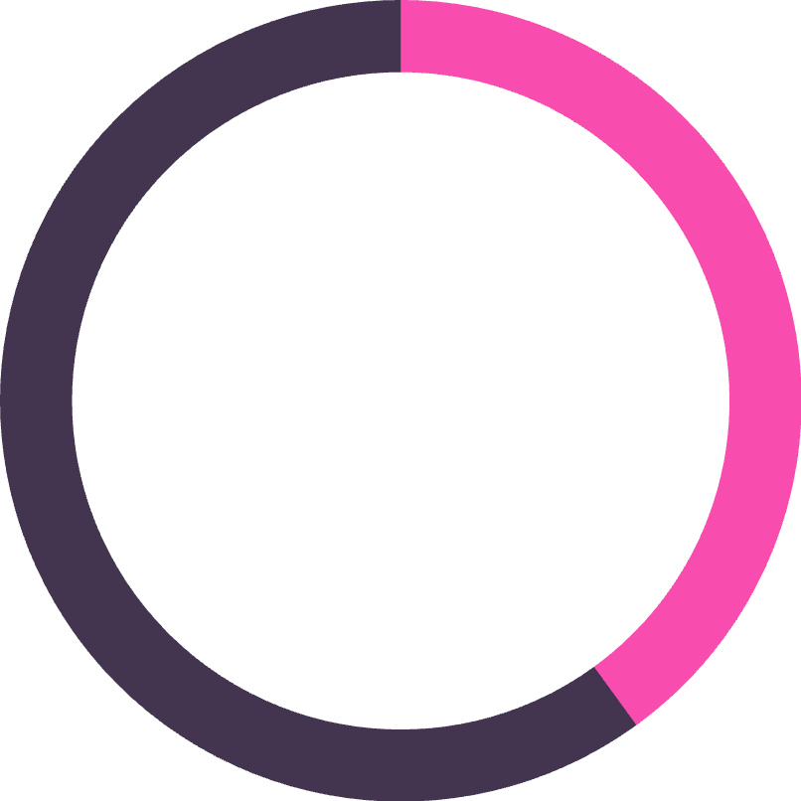
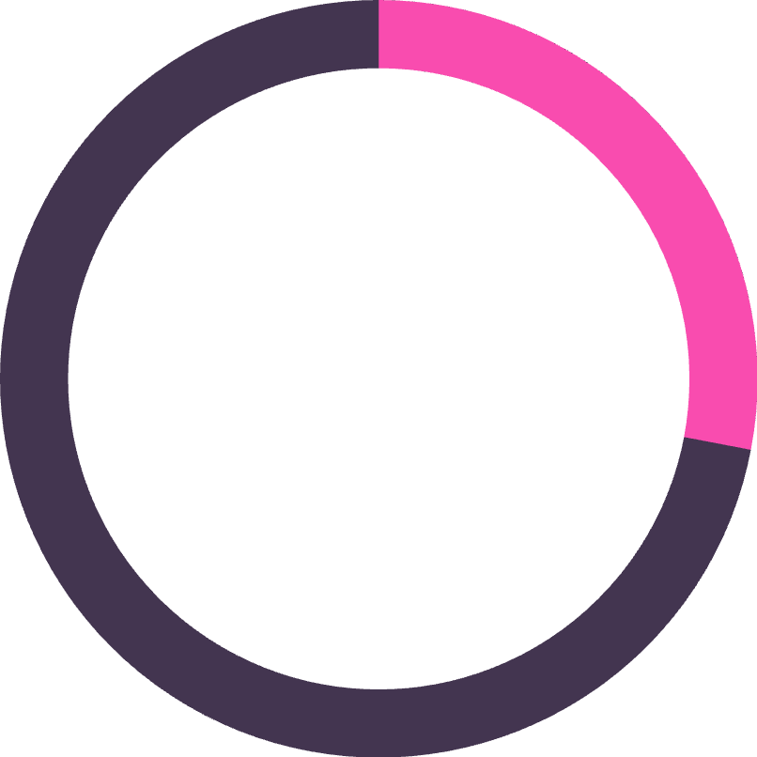
Implementation Benefits
Enhanced Decision Quality
Operational Efficiency
Continuous Improvement
Leadership gains strategic foresight through predictive analytics and portfolio-level insights whilst Scrum Masters receive tactical intelligence for daily execution.
Automated data collection, analysis, and reporting eliminate manual overhead. Teams spend less time generating reports and more time delivering value.
Pattern recognition identifies optimisation opportunities across sprints. Historical analysis informs process refinement and capability development.
65%
40%
28%
Reduction in reporting time
Faster decision cycles
Improved predictability

Slide 10
Platform Roadmap
Phase 1: Foundation
Phase 3: Automation
Core agent deployment, basic dashboards, and FastAPI infrastructure establishment
AI Agile Actions implementation, workflow automation, and proactive recommendation engine
1
2
3
4
Phase 2: Intelligence
Phase 4: Evolution
Advanced analytics, predictive modelling, and Ask Susan conversational interface launch
Machine learning model refinement, enterprise integrations, and continuous capability enhancement
Transform your Agile practice with intelligent, agent-driven insights that empower teams and leaders to deliver exceptional outcomes.

